Slide 1
HomeFit Videos

Slide 2

Videos Include
10 minute warm up
Cardio workout
Strength training
Different exercises each phase
Each exercise has beginner through advanced options
5 minute cool down

Slide 3

Three Phases
Phase 1 (Day 1-25)
Focus on losing fat
Introducing cardio
Phase 2 (Day 26-80)
Developing muscle
Increasing cardio endurance
Phase 3 (Day 81-100)
Toning muscle
Focus on intrinsic muscles

Slide 4
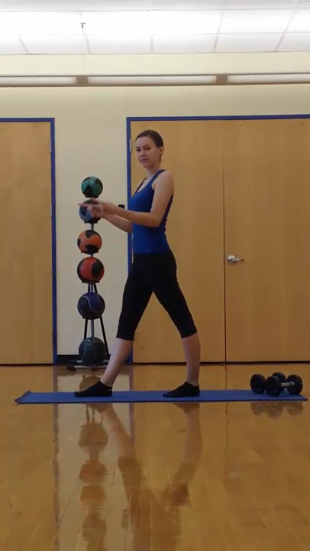
Sample Clip from a HomeFit Video
This clip shows part of a cool-down segment.

Slide 5
Packages
Package | Includes | Benefits | Cost
HomeFit Original | 1 hour of online video per day | Trim body fat and increase muscle | $30.00/month
HomeFit Plus | 15 hours of online video per week | More options for cardio and strength training | $45/month
HomeFit Extreme | 1 hour of online video per day plus weekly email consultations with a trainer | Personal attention to help you address your personal concerns | $50.00/month
HomeFit DVDs | 3 DVDs, one for each phase | Trim body fat and increase muscle | $85.00

Slide 6

Subscribe or Order Your DVDs Today!

